Slide 1
Requirements Engineering
— a presentation by Dr. K
Based on Chapters 6 and 7 of
Software Engineering: A Practitioner’s Approach (9th ed.)
by Roger Pressman and Bruce Maxim.
Notes:
Hello! This is Dr. K. Welcome to this week’s module – Module 4 – on Requirements Engineering, which is based on chapters 6 and 7 of Software Engineering: A Practitioner’s Approach by Roger Pressman and Bruce Maxim. In this module we will talk about what it takes to gather together the requirements for a project. And we will discuss why that is *just* *so* hard to do. We’ll *also* spend a little time on some software engineering principles that are associated with each of the framework activities.

Slide 2
Principles that Guide Practice
Notes:
Before we start talking about requirements in depth, we are going to spend a little time on software engineering principles. You can think of this chapter in Pressman as a little taste of what’s to come in the subsequent chapters. [–] And since these slides are mostly long lists of principles, I’m not going to go over each one, I’m just going to hit the highlights, so you might want to either pause the video on each slide and read the principles for yourself, or you can just review the slides by themselves after you watch the video. In each of these lists, I’m going to try and emphasize a few items that I think are important or otherwise noteworthy.

Slide 3
Core Principles
Be agile.
Focus on quality.
Be ready to adapt.
Build an effective team.
Establish mechanisms for communication and coordination.
Manage change.
Assess risk.
Create work products that provide value for others.
Notes:
We start with a few principles that pertain to processes in general. There were a few things that struck me when reading this section of Pressman. The first was, that agility is something you should pursue regardless of whether you are using a prescriptive or an agile process. Also, managing change means having some mechanism for managing the way that changes are requested and implemented. Finally, assessing risk includes establishing contingency plans for when something does go wrong. In general, it’s interesting to me how many of these principles echo the agile principles we discussed in the last module.

Slide 4
Principles of Practice
Divide and conquer.
Understand abstraction.
Strive for consistency.
Focus on transfer of information.
Build modular software.
Look for patterns.
Show the problem and solution from different perspectives.
Remember that someone will maintain your software.
Notes:
Here are some general principles that Pressman talks about. From my point of view, these look like design principles that the developers or programmers should follow: patterns, modularity, abstraction... One of the most interesting is the last one: remember that someone is going to maintaining the software that you create. So when you are designing your system, when you are writing your code, always keep in mind that someone is going to have to understand what you have designed, and someone is going to have to read what you’ve written. If you can keep that thought in the back of your mind, your system is going to be of much higher quality than it would otherwise be.

Slide 5
Communication Principles
Listen.
Prepare before you communicate.
Use a facilitator.
Talking face-to-face is best.
Take notes & document decisions.
Strive for collaboration.
Stay focused.
Draw a picture to clarify.
When you agree, move on; When you disagree, move on; When you’re blocked, move on.
Negotiation is not a contest.
Notes:
Here are some communication principles. I think most of these are common sense. The first one here is probably the most important. Just be a good listener. When you’re gathering requirements, this is going to take you the furthest. Most of us love to hear ourselves talk, but if you’re a good listener, you’re going to be a good requirements gatherer. A few other highlights: Pressman really big on having a facilitator in requirements gathering meetings, and I think one of the reasons for that is related to one of the last principles here about moving on. It can be very easy to get side-tracked or to get stuck in one particular topic when it comes to discussions about requirements. A good facilitator knows how to prevent that. Here’s how Pressman puts it: “Once you agree on something, move on; If you can’t agree to something, move on; If a feature or function is unclear and cannot be clarified at the moment, move on. [pause] So with that, let’s move on.

Slide 6
Planning Principles
Understand the project scope.
Involve stakeholders in planning.
Planning is iterative.
Estimate based on what you know.
Consider risk when planning.
Be realistic.
Adjust granularity in the plan.
How will you ensure quality?
How will you handle change?
Track the plan; adjust as required.
Notes:
A big part of planning is understanding the scope of the problem. Some of these things are obvious like involving the customer and defining how you’re going to ensure quality or accommodate change. Estimate based on what you know means that you estimate based on what you know you are going to build, not on what you might decide to build in the future. Being realistic means don’t assume that your team is going to work 100 percent of every day. And adjusting granularity just means that as a project plan is developed you can become more detailed about what is involved in that plan.

Slide 7
Modeling Principles
The primary goal of your team is to build software, not models.
Don’t create unnecessary models.
Keep your models simple.
Build models that can change.
Each model has a purpose.
Adapt the model to the system.
Build useful (not perfect) models.
A model should communicate content, syntax is secondary.
If a model feels wrong, it is.
Get feedback as soon as possible.
— Scott Ambler Agile Modeling
Notes:
The modeling principles that Pressman gives here come from a book by Scott Ambler called “Agile Modeling.” It’s worth noting that the a lot of agile development processes don’t talk a lot about modeling. In fact, most agile developers would probably agree strongly with the first principle here: the primary goal is software, not models. Agile development often seems to de-emphasize the modeling activity in favor of the development activity. This is something that seems to concern Pressman. And it’s almost as if he wants to emphasize here that you can be agile and still create analysis models and design models.

Slide 8
Construction Principles
Understand the problem.
Understand design principles.
Pick an appropriate language.
Pick appropriate tools.
Create unit tests before code.
Follow structured programming.
Consider pair programming.
Use appropriate data structures.
Create appropriate interfaces.
Conduct code walkthroughs.
Unit test to find errors.
Refactor to improve quality.
Notes:
Okay, coding principles – this is the fun stuff. Two things that catch my eye here are test-driven development (writing tests before you write your code) and refactoring, which is improving the design of the software without changing its functionality.
Structured programming just means you break your code into modules and functions. Almost everyone uses structured programming today in some form, so this probably isn’t something most people need to worry about. Pair programming is something that is strongly advocated by the extreme programming process. Data structures are structures that hold data, like arrays, lists, maps, sets, and databases. Choosing the right one can be important.
For quality assurance purposes, code walkthroughs are always a good thing to employ.

Slide 9
Testing Principles
Tests should be traceable to requirements.
Test should be planned.
Pareto principles: 80% of all errors are in 20% of components.
Test from small to large.
Exhaustive testing is not possible.
Focus tests on complex code.
Consider testing documentation.
Track defects; look for patterns.
Include tests that show correct behavior.
Notes:
We will spend some time in a later module talking about testing. The first principle here mentions that tests should be traceable to requirements. The notion of traceability is an important one in a disciplined software process. The Pareto principle is something you should be familiar with. It says that 80% of the errors are found in 20% of the software. In other words, there are some components in your system that are going to be more complex than others. That’s also why the fifth principle here is important: focus your tests on those harder-to-understand components.

Slide 10
Deployment Principles
Manage customer expectations.
Test the complete deliverable.
Establish a support regimen.
Provide instructional materials.
Do not deliver buggy software!
Notes:
Finally, deployment principles. Most of these are self-explanatory, and all of them seem to relate to what you do before you deliver the software. The first one and the last one are probably most important. Make sure that you and the customer are on the same page – the customer should have a clear idea of what to expect from any given increment. And the last point here is critical: do *not* delivery code that doesn’t work. This needs to be emphasized because there is a lot of pressure to deliver whatever functionality that you and the customer agreed to. But it’s better to deliver a subset of that functionality that actually works, then it is to deliver the complete functionality if it has known bugs in it.
Okay, that concludes our quick look at Pressman’s principles. In the next video, we’ll begin talking about requirements and requirements gathering.

Slide 11
Understanding Requirements
Notes:
In this section, we’re going to get an overview of requirements engineering.

Slide 12
Requirements Engineering Activities
Inception – Establish a basic understanding of the problem and the nature of a solution.
Elicitation – Draw out the requirements from stakeholders.
Elaboration – Create analysis model: represent information, functions, and behavior.
Negotiation – Agree on a deliverable system that is realistic for both developers and customers.
Specification – Describe requirements formally or informally.
Validation – Review the specification for errors, ambiguities, omissions, and conflicts.
Requirements management – Manage changing requirements.
Notes:
Requirements engineering is made up of several activities. The various activities you see here don’t always overlap neatly with a single framework activity. Let’s go over them briefly.
Inception is where you try to understand the problem; elicitation is where you actually collect the requirements; elaboration is where you model the requirements; negotiation is where you negotiate the deliverables; specification is where you describe the requirements; validation is where you check the requirements; and requirements management is managing changing requirements.
Okay, let’s look at each one of these and try to match them up with the framework activity in which they would occur. And remember, the framework activities are something you should know by heart: communication, planning, modeling, construction, and deployment. There is also the possibility that one or more of these requirements engineering activities might be more suitable under an umbrella activity. Okay, so let’s pause and think here: Look at these activities, and tell me what framework activity (or umbrella activity) they would occur in.

Slide 13
Pause and Think
Match the requirements engineering activity with the framework activity where it occurs.
Inception
Elicitation
Elaboration
Negotiation
Specification
Validation
Management
Communication
Planning
Modeling
Construction
Deployment
Umbrella
Notes:
[pause 5 seconds] Okay, ready? For inception and elicitation, I think it’s pretty straight-forward that these belong to the communication activity [next] Requirements elicitation is more or less synonymous with requirements gathering.
Requirements elaboration is basically the same thing as requirements analysis. That’s where you’re going to build the analysis model. [next]
Negotiation – to me – seems like something that happens during planning, so I’m going to match it to that. [next]
Specification and validation, those are activities where you are describing the requirements more precisely and checking that description. For that reason, I would also match those with modeling. [next] Although, I think the case could be made that since validation is a kind of testing, you could put it under the construction activity also. [next]
Finally, requirements management is about managing changing requirements, and that is something you have to do during the entire course of the project, so I would call that an umbrella activity [space] perhaps falling under configuration management.

Slide 14
Establishing the Groundwork
Identifying stakeholders
Recognizing multiple viewpoints
Working toward collaboration
Asking the first questions
Nonfunctional requirements
Traceability
Notes:
Establishing the groundwork is what takes place during inception. Understand that a stakeholder is anyone who benefits either directly or indirectly from the system being developed: customers, users, developers, and so on.
Most of these bullets are common-sense practices that you can read in Pressman, but I’d like to focus a little time on the fourth bullet: Asking the first questions.

Slide 15
First Questions (identify stakeholders)
Who is requesting the work?
Who will use the solution?
What will the economic benefit be?
Is there another source for the solution?
— Req. Engineer
Notes:
The first set of questions that Pressman gives is geared toward identifying the stakeholders. Who is requesting the work? Who will use the solution? And so on.

Slide 16
First Questions (understand problem)
What would be a good output generated by the solution?
What problems will the solution address?
What business environment will the solution be used in?
Will performance issues or constraints affect the way the solution is approached?
— Req. Engineer
Notes:
The second set of questions is geared toward understanding the problem you are trying to solve by developing the software, which is referred to as the “solution” in these questions. Questions like: “What is a good output?” and “What problems will the solution address?” are examples of questions the will help you understand the problem.

Slide 17
First Questions (assess communication)
Are you the right person to ask?
Are my questions relevant?
Should I be asking anything else?
Should I be talking to anyone else?
— Req. Engineer
Notes:
Finally, the last set of questions are to help you assess how well you are communicating with the stakeholder. For example: “Are you the right person to ask these questions to?”; “Is there anything I didn’t ask that I *should* be asking?”; and finally: “Should I be talking to anyone else.”
You should recognize that having a lot of stakeholders, means that you will hear many different points of view on what the project should entail. But you should expect that at this point in the process. Ideally, you would like to eventually merge those perspectives and get everyone on the same page.

Slide 18
Getting Requirements Right
The hardest single part of building a software system is deciding what to build. No part of the work so cripples the resulting system if done wrong. No other part is more difficult to rectify later.
— Fred Brooks
The seeds of major software disasters are usually sown within the first three months of commencing the software project.
— Capers Jones
We spend a lot of time—the majority of the project effort—not implementing or testing, but trying to decide what to build.
— Brian Lawrence
Notes:
Before we talk about requirements elicitation (or requirements gathering) I want to give you a few quotes on the importance of understanding requirements.
The first is by Fred Brooks of “No Silver Bullet” fame. He says:
The hardest single part of building a software system is deciding what to build. No part of the work so cripples the resulting system if done wrong. No other part is more difficult to rectify later.
Casper Jones says:
The seeds of major software disasters are usually sown within the first three months of commencing the software project.
And Brian Lawrence says:
We spend a lot of time — the majority of the project effort — not implementing or testing, but trying to decide what to build.
I’m sure you can find other quotes out there on the web about the importance of getting the requirements right. It’s a bit remarkable, that so many working software engineers put so much emphasis on requirements, in part because software engineering seems like it is something that should be focused on design and construction. But here we have a bunch of real-world software developers telling us that the most important part of software engineering is, effectively, communication.
Wow.

Slide 19
Pause and Think
What is wrong with this list of elicitation challenges?
Boundary of the system is ill-defined.
Customers specify unnecessary technical detail that confuses objectives.
Customers are not completely sure of what is needed.
Customers have poor understanding of computing environment.
Customers don’t have a full understanding of their problem domain.
Customers have trouble communicating needs to the system engineer.
Customers omit detail that is assumed to be obvious.
Customers specify requirements that conflict with other requirements.
Customers specify requirements that are ambiguous or untestable.
Requirements change over time.
Notes:
Here is a list of bullet points that I no longer see in Pressman. But I think it’s instructive so let’s talk about it. A software developer might reasonably ask the question: “Why it is so difficult to understand what the customer wants?” And this list has some very good reasons for why it really is difficult.
But I remember the first time I saw this list, and something struck me as odd about it, though it took me a while to pinpoint exactly what it was.
If you are not sure what I’m talking about, I’ll give you 5 seconds to pause the video and try to figure out what is *odd* about this list of reasons for why it is so difficult to figure out what the customer wants. Five seconds starting from now.
[pause 5 seconds]
Alright. I know that the question is a bit vague, but there is something about communication that is missing here. And that is: Communication involves two people, and problems with understanding in communication also involves two people. But when you look at this list, it seems like the customer is always the one who is at fault.
Well, what if the developer does not understand the jargon that the customer uses, whose fault is that? Or what if the developer does not have a good understanding of the problem domain? Whose fault is that?
I remember interviewing for a job at NASA. They were doing work related to aviation and air traffic control, where the software was mission critical and had to work correctly the first time. At one point I asked one of the people interviewing me: Given the nature of your work, how important is it for the software developers to understand the problem domain? His answer did *not* surprise me: The domain knowledge that the developers have is *as* extensive as anybody’s in the industry. If you work here, you will become an expert on the aviation domain.
So do not put all the blame on the customer if understanding is a problem, make sure you – as the developer – have done everything you can to achieve a good understanding.

Slide 20
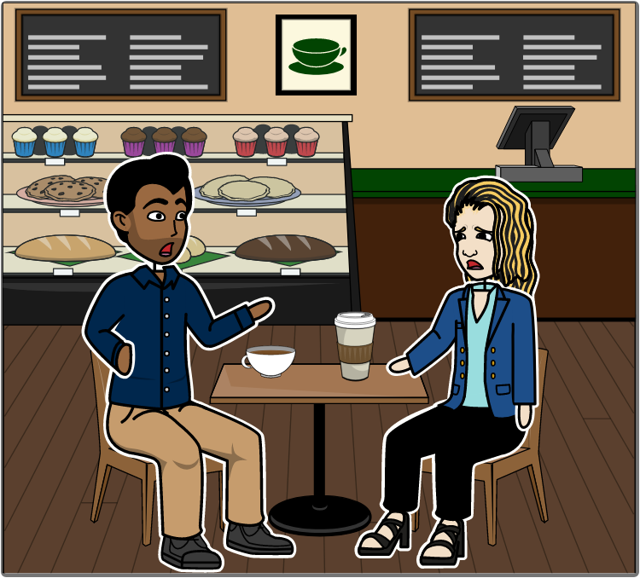
SafeHome: Communication [1]
The kickoff meeting for the SafeHome project is scheduled for next week.
Yeah, and I am not optimistic.
I called Lisa – the marketing manager – to ask a few questions about the product...
Notes:
Here is a portion of the SafeHome script that illustrates the challenges of communication. Vinod is reminding Jamie that the kickoff meeting for SafeHome is next week, and Jamie is *not* enthusiastic about it. She called up Lisa from marketing to ask her a few questions about the product...

Slide 21
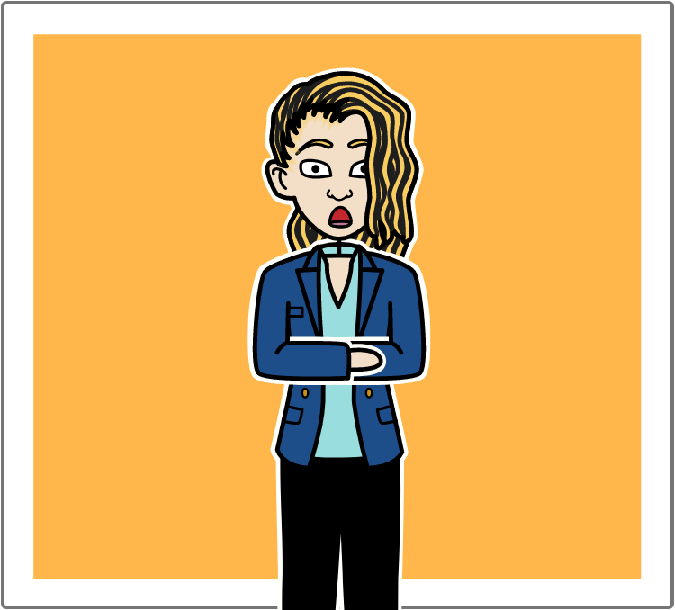
SafeHome: Communication [2]
Instead, she started asking me a bunch of questions about security systems and surveillance systems.
I’m no expert!
Notes:
But then Lisa started bombarding Jamie with questions. How do security systems work? How do surveillance systems work? And things like that. But Jamie doesn’t know any of that.

Slide 22
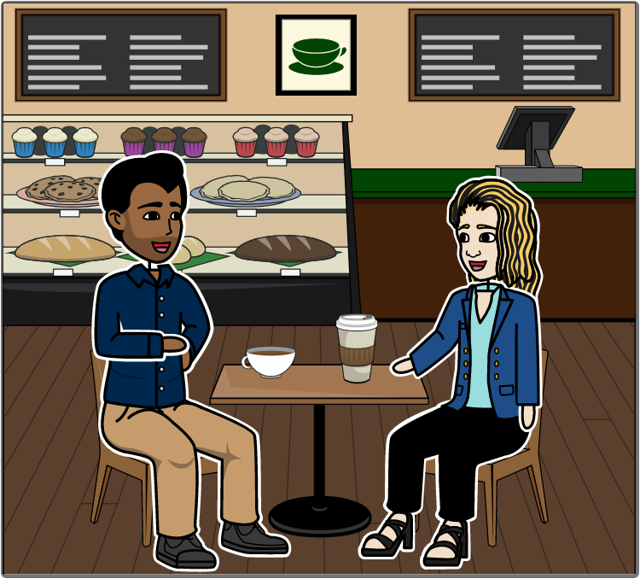
SafeHome: Communication [3]
Sounds like marketing is going to need us to act as consultants.
Yeah. And I probably should have stopped by her office instead of calling.
We’d better do some homework!
We’ve got to get our act together or communicating will be a struggle.
Notes:
So Vinod – ever the realist – says that they have no choice but to learn about those systems. Jamie agrees, and puts in a quick plug for face-to-face communication.
The point is, that as a developer, you are not going to be just writing code for a bunch of unit tests that somebody else gives you. You’re going to have to understand *what* the system is supposed to do, and *how* it’s supposed to do it, and maybe even *why* it’s supposed to one thing and not the other.

Slide 23
Collaborative Requirements Gathering
Meetings are attended by developers and other stakeholders.
Rules for preparation and participation are made.
The agenda is formal but allows exchanges of ideas.
A facilitator is used.
A definition mechanism is used.
Notes:
Collaborative requirements gathering meetings are a good way to start collecting requirements. They are meetings in which customers, developers, and other stakeholders get together and try to work out the requirements for the product based on some preliminary descriptions of the product. There are rules for preparation and participation, there is a facilitator – Pressman loves facilitators – and someone is typically asked to write things down during the meeting. The *definition mechanism* you see here in the last bullet point is just the place where ideas are recorded. It could be a white board, wall stickers, a flip chart, or an application if you’re in a virtual meeting.

Slide 24
SafeHome CRG: Sample Product Request
Our research indicates that the market for home management systems is growing at a rate of 40 percent per year. The first SafeHome function we bring to market should be the home security function. Most people are familiar with “alarm systems” so this would be an easy sell.
The home security function would protect against and/or recognize a variety of undesirable “situations” such as illegal entry, fire, flooding, carbon monoxide levels, and others. It’ll use our wireless sensors to detect each situation, can be programmed by the homeowner, and will automatically telephone a monitoring agency when a situation is detected.
Notes:
Let’s look at an example from the SafeHome project. In this scenario, we’ll assume that an initial inception meeting has already taken place. One of the stakeholders is tasked to write a two-page product request. In this case, let’s assume that a marketing person from inside the company has already done this. They send it out to everyone who plans to attend the first CRG meeting. Each person who attends the meeting is asked to make a list of objects, services, constraints, and performance criteria for the product, based on the two page description. At the meeting, a combined list is created. And then the attendees break into groups that write mini-specifications for each item. The specifications are then analyzed in the same way the product description was, until you have all of your objects, services, constraints, and performance criteria.
Suppose this is an excerpt from a 2-page description that the marketing person wrote about the *home security function* of the SafeHome product. Now pretend you are a stakeholder that is going to attend the CRG meeting. Remember that we are looking for objects, services, constraints, and performance criteria. So let’s do this now. Please pause the video, and come up with at least a few objects, at least a few services, at least one constraint, and at least one performance criteria, that you think the final product should have, based on this description.

Slide 25
Pause and Think
Find objects, services, constraints, & performance criteria.
Our research indicates that the market for home management systems is growing at a rate of 40 percent per year. The first SafeHome function we bring to market should be the home security function. Most people are familiar with “alarm systems” so this would be an easy sell.
The home security function would protect against and/or recognize a variety of undesirable “situations” such as illegal entry, fire, flooding, carbon monoxide levels, and others. It’ll use our wireless sensors to detect each situation, can be programmed by the homeowner, and will automatically telephone a monitoring agency when a situation is detected.
Notes:
[pause 5 seconds] Finished? Okay, let’s see what Pressman came up with.

Slide 26
Objects, services, constraints, and performance criteria
Objects – control panel, smoke detectors, window and door sensors, motion detectors, an alarm, an event (sensor has been activated), a display, a PC, telephone numbers, a telephone call, …
Services – configuring the system, setting the alarm, monitoring the sensors, dialing the phone, programming the control panel, reading the display, …
Constraints – System must recognize when sensors are not operating, must be user friendly, must interface directly to a standard phone line, …
Performance criteria – Sensor event should be recognized within one second, an event priority scheme should be implemented, …
Notes:
For objects we’ve got the control panel, smoke detectors, sensors, alarms, and so on. For services we have configuring the system, setting the alarm, monitoring sensors, and so on. For these two features: objects and services, you may consider doing a grammatical parse of the description to start you off. That means you find all the nouns in the description, and they become candidates for objects. Then you find all the verbs in the system, and they become candidates for services. It doesn’t mean there will be a one-to-one relationship between nouns and objects for example, but it gives you a good place to start. Constraints and performance criteria may require a bit more thought. Here, some constraints are the the system should recognize when the sensors are not operating, the interface must be user friendly, and the system should interface directly to a standard phone line. Some performance criteria might be that a sensor even should be recognized within one second, and that an event priority scheme should be implemented.

Slide 27
SafeHome CRG: Sample Mini-Spec
The Control Panel is a wall-mounted unit that is approximately 230 x 130 mm in size. The control panel has wireless connectivity to sensors and a tablet. User interaction occurs through a keypad containing 12 keys. A 75 x 75 mm OLED color display provides user feedback. Software provides interactive prompts, echo, and similar functions.
Notes:
Recall that a control panel was one of the objects in the list of objects. Therefore, a breakout group at the CRG meeting might be assigned the control panel so they can come up with a mini specification of it. Here is an example of such a specification. Eventually this description would also be analyzed for objects, services, constraints, and performance criteria.
And that concludes this brief look at Collaborative Requirements Gathering meetings.

